Slide 1

Deep Neural Network: long short-term memory (LSTM)
Mina Farmanbar
Associate Professor, University of Stavanger
for engineers

Slide 2
long short-term memory (LSTM)
When we are working with the RNNs, we are having some particular limitations.
Difficulty in capturing long term dependencies.
Fixed length context window restriction.
These limitations can restrict RNNs ability to perform well.

Slide 3
long short-term memory (LSTM)
Imagine you are trying to predict whether you will need an umbrella tomorrow based on the weather patterns for the past few days.
Traditional methods might just look at recent days and make a simple prediction.
LSTM networks can remember both recent weather patterns and long-term trends, such as ongoing seasonal rain, like the fact that it's been rainy for the past few weeks in your area during the season.

Slide 4
long short-term memory (LSTM)
RNN cells are replaced by LSTM cells in the hidden units.
These memory cells have the gates called:
input
forget
output
These gates regulate the flow of information, allowing LSTM to selectively remember or forget information over the time.

Slide 5
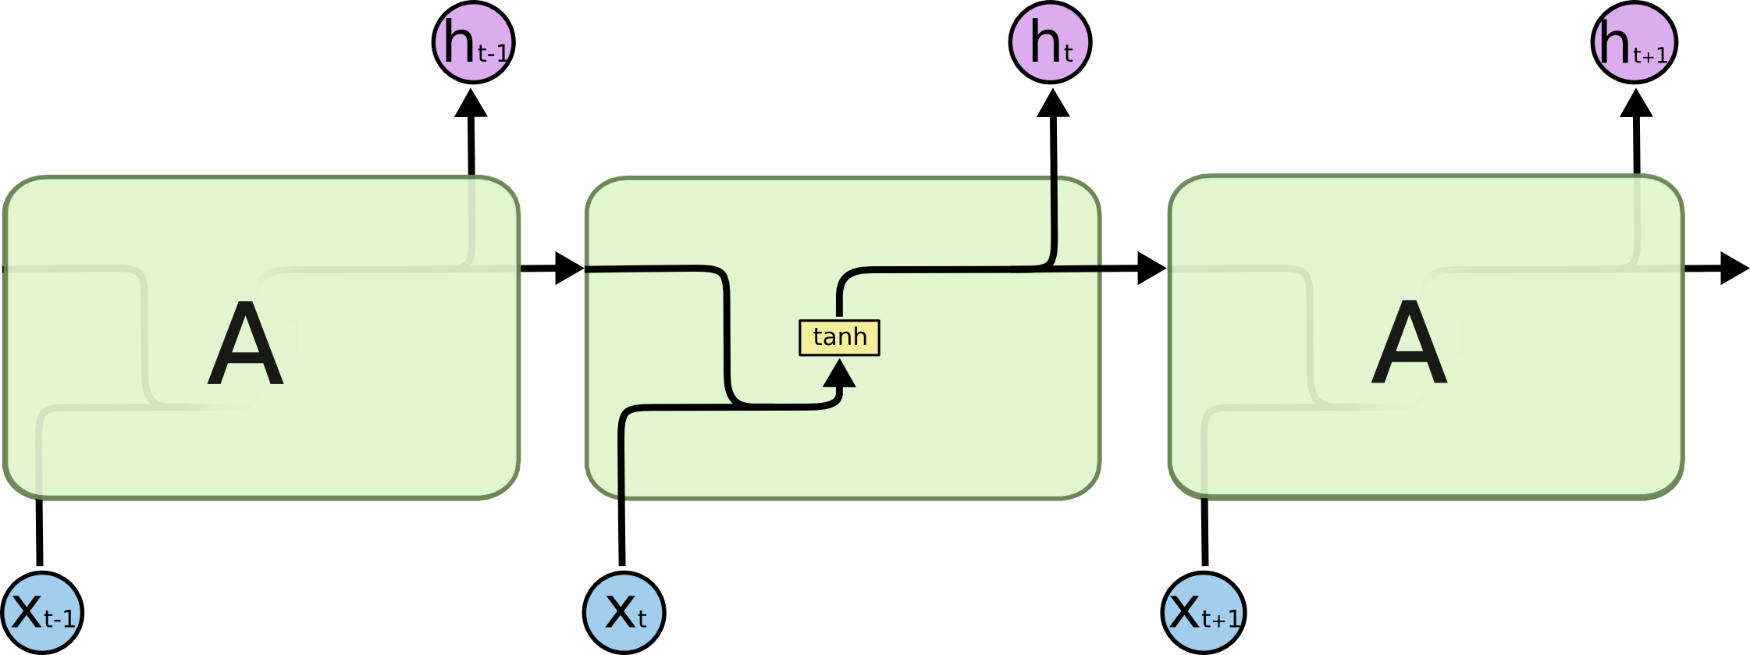

long short-term memory (LSTM)
Standard RNN
LSTM
https://www.codeproject.com/KB/Articles/1272354/lstm_chain.png

Slide 6
long short-term memory (LSTM)
While processing, it passes the previous hidden state to the next step of the sequence.
The hidden state acts as the neural network's memory.
It holds information on previous data the network has seen before.
https://miro.medium.com/v2/resize:fit:720/format:webp/1*yBXV9o5q7L_CvY7quJt3WQ.png

Slide 7
long short-term memory (LSTM)
Forget gate layer
Input gate Layer
Cell State
Output gate layer
https://miro.medium.com/v2/resize:fit:720/format:webp/1*yBXV9o5q7L_CvY7quJt3WQ.png

Slide 8
Summary
The Forget gate decides what is relevant to keep from prior steps.
The Input gate decides what information is relevant to add from the current step.
The Output gate determines what the next hidden state should be.

Slide 9
Thank you!
Mina Farmanbar
mina.farmanbar@uis.no

